Slide 1


Web Intelligence
Summer School 2014
Saint-Étienne, France
Notes:
sparqloud

Slide 2

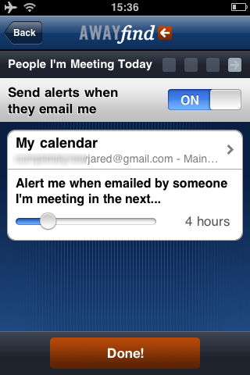
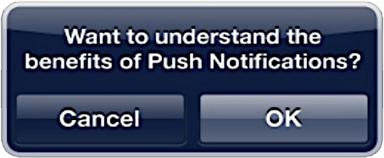



Slide 3


Message()
Registration
Notification
RegisterQuery()
UpdatedResults()
Controller
Query Execution
Result Fetching
Result Comparison
Triple Store
CheckOnUpdates()
GetQuestion()
Scheduler
[Q,E,R]
SPARQL(Q,E)
[Q,E,R]
Q → SPARQL Query
E → SPARQL Endpoint
R → Result Set
SPARQL

Slide 4


Slide 5
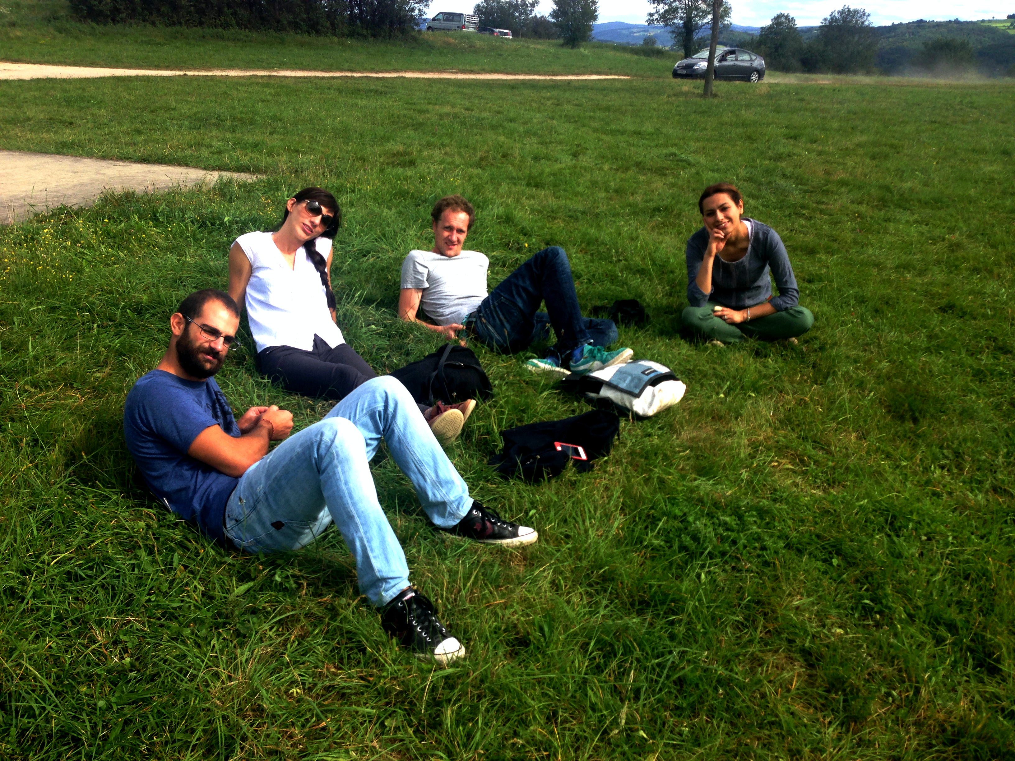
Thank you ☺

